Slide 1
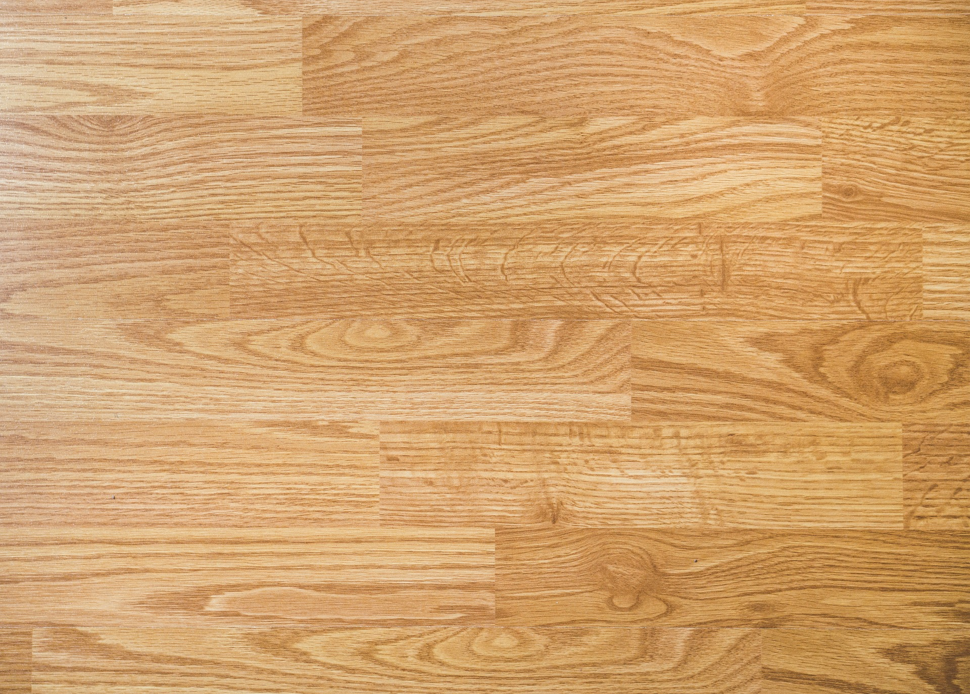
Stranded
Title added to title screen
START
HELP
Notes:
For this screen, I have added a title to the start screen so that the user can know if they are playing the right game and that the game doesn’t look unfinished.

Slide 2



How to play:
To win, you will need to collect all of the money without getting caught by an enemy. Watch out! The time is ticking! Make sure you collect the loot and reach the exit before the time is up..
Controls:
W – Move forwards
A – Move left
S – Move backwards
D – Move right
You!
Character being played is labelled.
‘Back’ added to title screen
Collect this!
And don’t forget!
Watch out for!
Back
Notes:
For this screen, I have made sure that the character being played is labelled and clearly displayed so that the user will not have to play to find out what they look like.
I have also added a ‘Back’ button so that if the user accidentally presses one of the buttons that they can simply just go back and do what they were going to again.
For this screen, I have also increased the sized of the font for the ‘How to Play and for the ‘Controls’ so that users with a minor sight impairments (in this case being able to read small fonts) will be able to see it better.

Slide 3
Select your difficulty!
Small amount of enemies, infinite time and unlimited health
Enemies cover larger area, limited time and 3 lives.
Fast moving enemies, covering a large area limited time and 1 life
EASY
Normal
HARD
Play with ease. No need to try-hard, just relax and let the flow of the game play for you.
Play the game at a difficulty where challenge is at a low and high at the same time.
Think you have what it takes to beat the 13+ year olds?
‘Back’ added to title screen
‘Help’ button added to screen
Back
HELP
Notes:
I have also added a ‘Back’ button to this screen so that if the user accidentally presses one of the buttons that they can simply just go back and do what they were going to again.
This screen also features a ‘Help’ button that takes the user to the ‘Help’ page if it is now in which they decide to do so rather than going back to it and then back to the home again.
I have also removed the Impossible mode, this is because it was an irrelevant joke and therefore pointless.
I have changed a slight bit of the descriptions for the ‘Easy’ mode for a phrase that fit the description better.

Slide 4




Easy
Timer to show how long is left of the level time
What the user needs to collect. Static sprite, will remove it as it is touched.
Difficulty of level
Enemy character. Sprite that moves within a collider.
What the user needs to collect. Static sprite, will remove it as it is touched.
The character the user is playing. Sprite that is moved by the user.
Enemy character. Sprite that moves within a collider.

Slide 5
Medium
Timer to show how long is left of the level time
What the user needs to collect. Static sprite, will remove it as it is touched.
Difficulty of level
Enemy character. Sprite that moves within a collider.
What the user needs to collect. Static sprite, will remove it as it is touched.
The character the user is playing. Sprite that is moved by the user.
Enemy character. Sprite that moves within a collider.

Slide 6
Hard
Timer to show how long is left of the level time
What the user needs to collect. Static sprite, will remove it as it is touched.
Difficulty of level
Enemy character. Sprite that moves within a collider.
What the user needs to collect. Static sprite, will remove it as it is touched.
The character the user is playing. Sprite that is moved by the user.
Enemy character. Sprite that moves within a collider.

